Slide 1


E-Business / E-Commerce
POWERPOINT TEMPLATE

Slide 2

AGENDA
Introduction
E-Business
Basics
Interaction
Pros and Cons
E-Business VS. E-Commerce
E-Commerce
Basics
E-Commerce Strategy
Methods
Development in Germany
Pros and Cons
ICT
Business model
Recap and Next Steps
Implementation and checklists

Slide 3

Introduction
E-Business and E-Commerce

Slide 4
INTRODUCTION
History
The development of the internet and e-business
1960’s the Internet was created 1970’S it expanded internationally 1990 the commercial stage of the Internet began the first online company was founded
eBay (online auction site), Yahoo! (search engine) and Amazon (online retailer) were established
1998 Google (search engine) was founded 2000 51 % of technological information was exchanged via the Internet
2004 Facebook (social network) was founded
2007 97 % of information was shared online, the iPhone was introduced 2008 cell phones have long been able to access the Internet, but only 13% of Germans use mobile Internet 2012 555 million websites exist
2015 56 % of Germans use mobile Internet

Slide 5
INTRODUCTION
Information Society
Information is becoming more and more significant in regards to production. Business processes are then transferred over to the Internet and customer relationships are developed through electronic information and communication.
E-Business and E-Commerce are emerging.
$

Slide 6


E-Business
E-Business and E-Commerce

Slide 7

E-Business
Electronic business or e-Business means the initiation, agreement and completion of electronic business processes that generate value over the Internet.
Andreas Meier, Henrik Stormer (eBusiness & eCommerce: Managing the Digital Value Chain)

Slide 8
We will continue to see a convergence of the digital and physical world. Those who conquer that trend will be market leaders.
John Phillips, Senior Vice President of Customer Supply Chain and Logistics for PepsiCo. Inc.

Slide 9


E-Business 1. basics
E-Business and E-Commerce

Slide 10
BASICS
Sources of E-Business
Sources of e-Business Activity
Previously established companies that develop an online presence in addition to their current business activities
New companies, whose key activities are made possible by the Internet

Slide 11
BASICS
Value Creation in E-Business
E-BUSINESS IMPROVES VALUE CREATION
E-BUSINESS ESTABLISHES VALUE CREATION
E-BUSINESS ESTABLISHES VALUE CREATION
Support
Process automation
Business expansion
Diversifi-cation
Innovation
Existing processes are supported by e-business
Optimizing and automating primary processes through e-business
E-business leads to expansion in the existing market
Horizontal and vertical diversification of supply
Creating new business models by using digital processes
FOLLOWER
MARKET MAKER

Slide 12
BASICS
Value Chain
EPRODUCTS & ESERVICES
EPROCUREMENT
EMARKETING
ECONTRACTING
EDISTRIBUTION
EPAYMENT
ECUSTOMER RELATIONSHIP MANAGEMENT

Slide 13
BASICS
Value Creation Process in E-Business
GATHERING INFORMATION
central, automated and simplified collection of information
all information in one place
PROCESSING INFORMATION
research and information costs are reduced by know-how processing
new recycling possibilities can be developed
TRANSFERRING INFORMATION
standard information transfer: value creation by supplying the product
automated information transfer: value creation by an automated supply of information, which could lead to an advantageous view of the product

Slide 14
BASICS
Example of Value Creation in E-Business
 | Gathering Information | Processing Information | Transferring Information | Added Value
 | Input | Process/ know-how | Output
Google | data about websites and search queries | aligns search terms and web content | lists of matching websites | overview of selection
Trip-Advisor | Data about destinations and prices, booking options and travel reviews | aligns travel deals and travel reviews | travel deals, destinations, travel reviews and price comparisons | overview of selection, transactions and exchanges

Slide 15

BASICS
Cycle of Information
Applying knowledge
acquiring Information
Structuring data
Database Research
E-Business
Database Research
Business Reengineering
Business Reengineering
Transferring information
Storing information
Business Reengineering
Business Reengineering
Data Mining
Data Mining
Structuring knowledge
Analyzing information
Processing information
Applying data

Slide 16
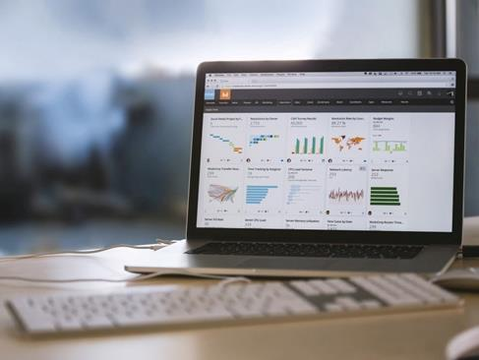
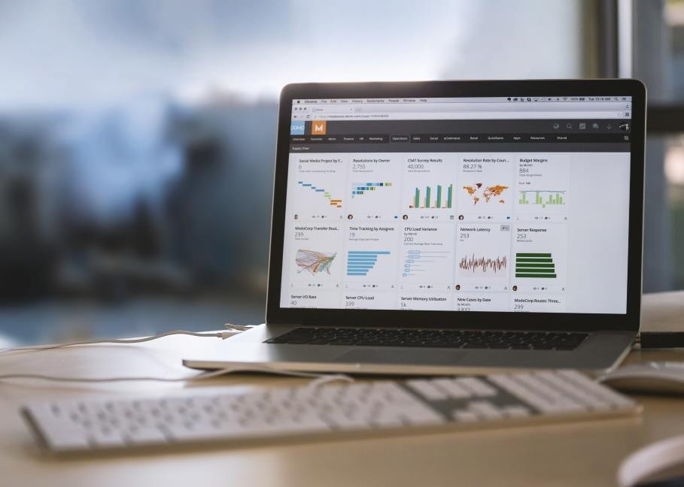
BASICS
Supporting Processes
STRATEGIC PLANNING
ORGANIZATION AND HUMAN RESOURCES MANAGEMENT
Supporting processes
CONTROLLING
SECURITY MANAGEMENT

Slide 17
BASICS
Categories of E-Business
E-Business
Electronic Transfer Within the Company
Customer Relationship Management
Supply Chain Management
Enterprise Resource Planning
E-Commerce
Business Intelligence

Slide 18




BASICS
E-Education
transferring education and training services
E-Communication
interactive, intra-organizational and inter-organizational collaboration
E-Commerce
initiating, negotiating and closing a trading transaction
E-Collaboration
providing communication platforms and the possibility for data/ information exchange

Slide 19
BASICS
Key Areas
E-INFORMATION:
E-COMMUNIcATION:
A source of information
example:
news, stock quotes, weather, etc.
A communication tool
example:
email, chats, discussion forums, VoIP applications, etc.
E-TRADING:
E-ENTERTAINMENT:
An electronic trade
example:
online retail, online flea market, etc.
Entertainment
example:
video services, gaming, music, etc.
Internet uses

Slide 20
BASICS
Key Functions
In each of the four key areas, new forms of value created business models can result when considering the key functions for Internet activities:
1
2
3
4
Search
Evaluation
Transaction
Problem solving

Slide 21
BASICS
Key Functions
Evaluation
better comparisons
reduced information asymmetry
improved search performance
lower search costs
Transaction
Search
reduced transaction costs
accelerated transaction process
Service-related offers
customer-based solutions and problem solving
individuality
Problem solving

Slide 22

E-Business 2. Interaction
E-Business and E-Commerce

Slide 23
INTERACTION
Variety of Electronic Business Relationships
 |  | Customers
 |  | Consumer | Business | Administration
Pro-viders | Consumer | Consumer-to-Consumer (C2C) e.g. product sale on a personal blog | Consumer-to-Business (C2B) e.g. job market | Consumer-to-Administration (C2A) e.g. citizens comment on public project
 | Business | Business-to-Consumer (B2C) e.g. online retail | Business-to-Business (B2B) e.g. online order at a supplier | Business-to-Administration (B2A) e.g. electronic services for public administration
 | Administration | Administration-to-Consumer (A2C) e.g. downloading forms | Administration-to-Business (A2B) e.g. public announcements | Administration-to-Administration (A2A) e.g. forms of cooperation with virtual communities

Slide 24


INTERACTION
Types of Interaction – Players
From the target function:
Consumers: maximizing benefits
Business: maximizing profits
Administration: maximizing welfare or voters
From the customizing level:
One: single player, completely individualized
Few: few players, identifiable members of a group
Many: many players, individually unidentifiable

Slide 25
INTERACTION
Types of Interaction – from Whom to Whom
From the Objective:
From the Individual Level:
FROM/ TO | CONSUMER | BUSINESS | ADMINI-STRATION
CONSUMER | C2C Communities, rating sites, forums, flea markets, auctions, chats | C2B Review and complaint sites, service purchasing auctions | A2G Blogs, petition sites
BUSINESS | B2C Shops, auctions, market, product and CRM sites | B2B Procurement, cooperation and information sites | A2G Shops, information sites
ADMINI-STRATION | A2C Civil service and legal information sites | A2B Specification and regulation info sites | A2G Cooperation and information sites
FROM/ TO | ONE | FEW | MANY
ONE | One2One chats | One2Few Shops, user group sites | One2Many Shops, public information sites
FEW | Few2One Procurement or announcement sites of an organization, lobby sites | Few2Few B2B Market places, collaborative procurement sites, cooperation networks | Few2Many Virtual malls, community sales, information sites
MANY | Many2One Petition sites, user group sites | Many2Few Community procurement | Many2Many Market places, forums

Slide 26
INTERACTION
B2B and B2C Transactions
Channel partners
(suppliers)
Channel partners
(Organization)
Suppliers
Organization
Consumer clients
Suppliers
Distributors
Kunde
Business-to-Consumer (B2C)
Business clients
Business-to-Business (B2B)

Slide 27
INTERACTION
Platforms
Information
Individual homepages and blogs, news, lists and directories, comparison sites, search engines
E-procurement
Individual and community procurement sites, state advertising sites
Trade
Individual online shops, online marketplaces, online auction platforms
Interaction
Chats, communities, forums, communications platforms, dating sites, online games
Entertainment
Online multimedia sites, online games
Bundles
Internet portals, industry-specific websites

Slide 28

INTERACTION
Sources of Revenue
Direct Sources
(from the online business trade)
Indirect Sources
(from online business info services)
Transaction revenues
Sales revenue, contributions and fees not related to performance
Commissions
Procurement fees, brokerage costs, forwarding commissions
Transaction-based revenues
Access or registration fee, handling or membership fees
Advertising revenues
Ads, blog/directory listings, search engine placement
Non-monetary exchange
File sharing, communities and user groups

Slide 29
INTERACTION
Practical Distribution of Revenue Sources
Source: Kupona.de, 2015

Slide 30




INTERACTION
Communication Tools
Homepage, online shop, online market
Blogs, rating sites, forums, user groups
Direct mail
Online advertising

Slide 31
INTERACTION
Different Types of Communication Tools
COMMUNICATION TOOLS CAN BE DIVIDED INTO THE FOLLOWING GROUPS:
Active communication tools
Reactive communication tools
The company complies with customers without being asked.
The company complies only after the customer requests it.

Slide 32


E-Business 3. pros and cons
E-Business and E-Commerce

Slide 33


PROS AND CONS
Overview
PROS:
E-business increases productivity by saving money and time.
It gives access to information anywhere, anytime.
It even benefits small markets.
It provides low-cost advertising for the company and its products.
CONS:
Technical expertise is a prerequisite.
Users must have Internet access.
Online advertising can be irritating to consumers which is harmful to the company, or is simply ignored (banner blindness)
Comparison and information portals increase the stress of competition.

Slide 34

E-Business 4. E-BUSINESS vs. E-COMMERCE
E-Business and E-Commerce

Slide 35
E-BUSINESS VS. E-COMMERCE
E-Business and E-Commerce Tasks
E-BUSINESS IS MORE THAN ONLINE SALES AND MARKETING.
E-Business:
Improving performance through reduced costs and open connectivity:
new technologies in the value chain
connecting them across other companies
improve service
lower costs
open new channels
E-Commerce:
marketing
selling
buying online products/services

Slide 36
E-BUSINESS VS. E-COMMERCE
The Relationship between E-Commerce and E-Business
There are three different approaches:
EC
EB
E-commerce and e-business have a few common characteristics.
EC=EB
E-commerce is almost identical to e-business.
EB
EC
E-commerce is a section of e-business.

Slide 37
E-BUSINESS VS. E-COMMERCE
E-Commerce as a Section of E-Business
E-commerce
E-BUSINESS
VS
Der Fokus liegt auf dem Verkauf von Waren oder Dienstleistungen.
The focus is on the sale of goods or services.
This also includes other operations such as communications, data exchange, etc.

Slide 38

E-BUSINESS VS. E-COMMERCE
E-Commerce as a Section of E-Business
Settle
Administer
Develop
E-BUSINESS
E-Commerce
Buy and Sell
Advertise
Process
Negotiate
Inform
Recruit

Slide 39

E-Commerce
E-Business and E-Commerce

Slide 40

The information highway will transform our culture as dramatically as Gutenberg‘s press did the Middle Ages.
Bill Gates

Slide 41

DEFINITION
E-Commerce
"Electronic Commerce includes electronically supporting activities that are directly related to the buying and selling of goods and services via electronic networks [...].“
Bernd W. Wirtz

Slide 42

E-Business 1. BASICS
E-Business and E-Commerce

Slide 43

BASICS
E-Commerce Process
Store Management
9
Customer Support
8
1
Systems (websites, online shops)
Order Fulfilment
7
2
Creativity
Tax Compliance
6
3
Revision
5
4
Payment and Fraud Management
Marketing

Slide 44
BASICS
E-Commerce Value Chain
Management
Interfaces for upstream companies
Research and Development
Interfaces for all downstream partners and customers
Human Resources
Management/ Controlling/ Finance/ EDP
Inbound Logistics
Production
Marketing Sales SEO
After-Sales
E-Commerce Field

Slide 45
BASICS
A Website is Only "the Tip of the Iceberg"
Representation
Website
System Integration
E-Commerce
Newsletter
Personal Information Manager
Order processing
Web analysis
Enterprise-Resource-Planning
Customer-Relationship-Management
Finance / Budgets
Peripheral systems

Slide 46
BASICS
The Effect of the Internet
Internal effect
External effect
Cost reduction
through process efficiency
Sales
e.g. branches
Expense
For producing goods and services
Increase in sales
(through e-business) and multi-channel efficiency

Slide 47


BASICS
Marketing Steps of E-Commerce
SEM SEARCH ENGINE MARKETING
SEO
SEARCH ENGINE OPTIMIZATION
Steps to be taken to attract visitors to a website through search engines
Steps to be taken to be listed higher in search results

Slide 48

E-Business 2. E-COMMERCE-STRATEGy
E-Business and E-Commerce

Slide 49




E-COMMERCE STRATEGY
General
Traffic
Visitors
Orders
Traffic
Sales
X
conversion
=

Slide 50
E-COMMERCE STRATEGY
4 Steps in E-Commerce
01
02
03
04
POSITIONING The concept of e-commerce should offer the potential of sufficient difference to successfully gain the market share, for example, USP (unique selling point)
VALUE Striving for customer focus, quality and efficiency, known as "operational excellence," contributes greatly to e-commerce success, and should increase or, at best, enhance the USP.
BEST PRACTICES
The advantage of a market analysis is, for example, focusing on the “top of the class". Some businesses who use this are Amazon or Zalando.
CHANGE Analyzing and pursuing laws and methods contribute to the success of e-commerce. Make sure that new behavior is strengthened and the right tools are used.

Slide 51
E-COMMERCE STRATEGY
The Strategy in Detail
Phase 1
Phase 2
CURRENT STATE
TARGET STATE
NECESSARY MEASURES
Strategic analysis
Analysis of internal resources
How strong is the company?
Bundling a portfolio
What is the current overall situation?
Analysis of internal resources
How strong is the company?
Creating a strategy
Implementation
Strategic positioning
How can you position the company to achieve success?
Monitoring and control
How can implementation be organized?
Strategic planning
What goals should the company pursue?
Strategy conforming measures
What are the necessary actions to achieve said goals?

Slide 52
E-COMMERCE STRATEGY
The Strategy and Your Topics
STRATEGIC/ ANALYTICAL LEVELS
1. Basis
2. Traffic
3. Conversion
4. Shopping Cart
5. Customer Loyalty
Goals, resources, customers, system platforms
Offline and online communication
Information architecture, structure, search, simple processes
Recommendations, reviews, special offers, gifts
Customer Support, service, customer loyalty programs
TOPICS

Slide 53
E-COMMERCE STRATEGY
The Optimal E-Commerce Shop System
Manage products and orders efficientlyt
Get the customers where they are located
Product Overview
Interfaces
Merchandise management
SEO & MOBILE
HOSTING
shopsystem
SOCIAL MEDIA
CONTROLLING
ONLINE MARKETING
Give customers optimal shopping
Motivate customers to buy
Logistics
Conversion
Payment Systems
Design
Shopping Cart
Campaigns
Cross and Upselling
User-friendliness

Slide 54

E-Business 3. METHODs
E-Business and E-Commerce

Slide 55

METHODS
Introduction
To create a successful e-commerce concept, it is important to get an overview of the whole situation of the company. The following methods are used:
ERP (ENTERPRISE-RESOURCE-PLANNING)
CRM (CUSTOMER-RELATIONSHIP-MANAGEMENT)
PIM (PRODUCT-INFORMATION-MANAGEMENT)

Slide 56
METHODS
ERP – Enterprise Resource Planning
Enterprise-Resource-Planning. What is it?
Inventory
Vendors
Enterprise resource planning controls various company resources (e.g. equipment, materials, capital, staff, etc.).
This should be done to ensure that an efficient value chain and permanent control of processes are implemented according to the purpose of the company.
Purchasing
ERP
Finance
Payroll
Sales

Slide 57
METHODS
CRM – Customer-Relationship-Management
Customer-Relationship-Management. What is it?
Customer relationship management is a strategy for the systematic approach to all interactions and relationships with the customers of a company. This applies to both existing and potential customers. The key elements for successful customer relationship management are marketing, sales, support and feedback.
marketing
crm
sales
support
feedback

Slide 58
METHODS
PIM – Product-Information-Management
Product-Information-Management. What is it?
Product information management provides product information for different output media, distribution channels and geographic locations which serve as the basis for e-commerce. This information needs to be managed, maintained and modified in a centralized system to provide relevant data to all channels without great expenditure of resources.
Product-Information- Management (PIM)

Slide 59

METHODS
PIM – Product-Information-Management
SOURCES / SYSTEMS
Product-Information- Management (PIM)
INSTORE
MOBILE
MEDIA / ASSETS
E-COMMERCE / WEBSITE
E-CATALOG
NEWSLETTER
SUPPLIER
OTHER CHANNELS

Slide 60

METHODS
Businesses and Their Multichannel Strategy
A multi-channel strategy is when both the online and the offline world is integrated into one business plan.
Examples:
Ikea – virtual inspiration for retail shopping
eBay – local sellers are members of the digital shopping world

Slide 61

E-Business 4. DEVELOPMENT IN GERMANY
E-Business and E-Commerce

Slide 62

DEVELOPMENT IN GERMANY
E-Commerce Sales in the Past Years
BN €
Source: HDE forecast

Slide 63
DEVELOPMENT IN GERMANY
Traditional Ordering vs. Online Ordering Methods
7,2 BN €
Total about 41.9 BN €
41,9 bn €
Source: bevh study "Interaktiver Handel in Deutschland B2C", 2015

Slide 64

E-Business 5. pros and cons
E-Business and E-Commerce

Slide 65

PROS AND CONS
Advantages and Disadvantages for the Provider
PROS:
24/7 availability
additional distribution channels
global reach
quick updates
customer profiling
equal opportunity
saving time and costs
no physical location disadvantage
CONS:
high start-up costs
quicker market share loss
customers can remain unknown

Slide 66
PROS AND CONS
Advantages and Disadvantages for the Consumer
PROS:
saving time and costs
convenience
no dependence on opening hours
immediate price comparisons
easy to shop internationally
anonymity
additional information channels
CONS:
no social shopping experience
possible privacy breach of the provider
cannot physically touch, look at or try out the product
delivery times
limited availability

Slide 67

ICT
E-Business and E-Commerce

Slide 68
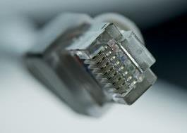


ICT
Types of Information and Communications Technology
In e-business, customer relationships are developed through electronic information and communication technology (ICT). There are 3 types:
Internet Technology
So far, these have the greatest potential:
Internet
Intranet
Extranet
Mobile Devices
M-business: within the last decade, the development of smart phones has increased the most.
Interactive TV
So far, this hasn‘t be very widespread in Germany.

Slide 69

ICT
Internet
Internet is described as a network of different computers that communicate and exchange information. The Internet allows any computer to interact with each other in various ways.
Inter
= between (Latin)
Net
= networking
+

Slide 70

ICT
Internet – Intranet – Extranet
The difference among Internet, Intranet and Extranet lies in the use of Internet technology.
internet
Company 2
extranet
intranet
Company 4
Company 1
Company 6
Company 5
Company 3
Company 7

Slide 71

ICT
Intranet
Intra
= within (Latin); inwardly
Intranet refers to a network that makes use of the Internet, however, is characterized by unity and corporate confidentiality. Only an authorized group, such as a company's staff can access it, making it a cost-effective tool of internal corporate communications.

Slide 72
ICT
Extranet
Extra
= outside (Latin); except, beyond
Extranet is defined as an extension of Intranet, because now the user group is increased. Thus, it can be accessed not only internally but also used by external interested parties such as suppliers and customers. These may include placing further orders or retrieving price lists and product information. Access to the information database is limited in contrast to the Internet.

Slide 73
ICT
Comparison to Specific Characteristics
Internet | Intranet | Extranet
Unlimited user group | Internally limited user group | Externally limited user group
Anonymous users | Known users | Known users
No identified operators | Identified operators | Identified operators
Open & unprotected | Closed & protected | Relatively closed & protected

Slide 74

ICT
M-Business
M-Business: E-business on mobile devices
The aim, however, it is not merely to make the same applications available for mobile device users and computer users but also to develop new and customized technologies.

Slide 75

ICT
Special Features of M-Business
Personalizing:
Both users and their location are clearly identified, so offers can be customized.
Up-to -date:
Unlike computers, mobile devices are always in use. So, it is possible to keep the users informed of important events. (latest news, stocks, discounts, special offers)
Territorial Nature
Location-based marketing: the current location can always be determined by the GPS on mobile phones. Therefore, it is possible to advertise individual location-based services and information.

Slide 76





ICT
Advantages on the provider‘s side
Reliable customer location
Constant customer availability
Unification by a few standards
Personalized and one-to-one relationship
Increased security for payment transactions

Slide 77





ICT
Advantages on the consumer‘s side
Unrestricted location and routing
24/7 service availability
Interactivity and individuality
Multimedia (text, audio and video)
High speed and comfort

Slide 78

Business Model
E-Business and E-Commerce

Slide 79
BUSINESS MODEL
4Cs- Characteristics by Bernd W. Wirtz
 | Content | Commerce | Context | Connection
Description | collecting, selecting, systematically representing, compiling and delivering content | initiating, negotiating and settling business transactions | classifying and systematically representing available information on the Internet | establishing the possibility of exchanging information within networks
Objective | providing online delivery from consumer-centric and personalized content | supplementing or replacing traditional transaction phases over the Internet | reducing complexity, navigating | creating technological, commercial or communicative relationships within networks
Revenue Model | indirect revenue models | transaction-based, direct and indirect revenue models | indirect revenue models | direct and indirect revenue models
Examples | Financial Times Deutschland, Spiegel Online | Amazon, eBay | Yahoo!, Google | GMX, Facebook

Slide 80

BUSINESS MODEL
Explanation of Terms
Business models represent business activities, to gain a realistic overview of chances of success. This is especially useful for setting up companies (startups), spin-offs and market entry for unknown businesses.
Those primarily addressed:
decision makers
venture capitalists
potential shareholders
customers

Slide 81
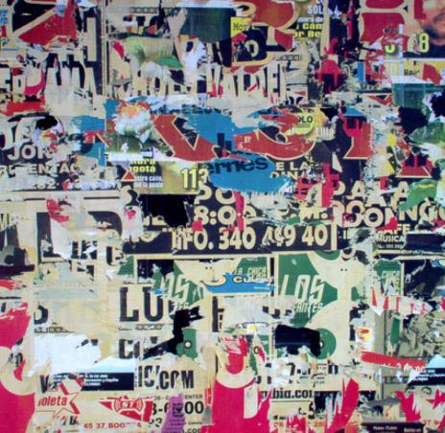
BUSINESS MODEL
Example – Free!
The company offers its services for free, which attracts users and market shares very quickly.
Who pays?
Revenue by advertising
Free! generates earnings by switching advertisements.
The Internet enables targeted advertising messages and the collection of customer information.

Slide 82

BUSINESS MODEL
Example – Freemium
In Free!, revenue from advertising can only be generated by advertising (price) market.
An alternative is Freemium:
Free + Premium = Freemium
After free services are offered, fee-based packages / additional services are supplemented.

Slide 83

BUSINESS MODEL
Example – The Long Tail
Generally, each stock contains poorly sold goods (non-selling stock), which cost money by their space usage.
However, there are no storage costs for digital products which boosts a wide range of niche products including sales and revenue:
direct selling
by advertising like Free!

Slide 84

BUSINESS MODEL
Example – The Market Place Model
With the Marketplace model, content created by the customer both in digital and material form. Every user can offer (niche) products and platforms that serve as distribution channels as well as request a fee for transactions. Successful products are incorporated into their own range.
Some costs are outsourced for:
procurement
warehousing
shipping

Slide 85

Recap and Next steps
E-Business and E-Commerce

Slide 86

There are so many opportunities on the horizon, from mobile exclusives to geo-located offers to better filtering and searching. We‘ve only scratched the surface of what‘s possible with personalization.
Michelle Peluso, CEO Gilt Group

Slide 87
RECAP AND NEXT STEPS
Online Retail Sales from 2012 to 2017
Billion €
70
64,1
59,68
UK
60
54,85
49,91
45,02
46,36
50
42,52
Germany
40,11
38,45
40
34,55
30,87
30,68
28,18
France
30
27,15
25,72
20,62
23,22
20
17,99
5,49
5,6
6,15
8,34
10
3,99
4,73
Italy
0
2012
2013
2014
2015
2016
2017
Source: Forrester Research, Tech Crunch (Statista 2014)

Slide 88
RECAP AND NEXT STEPS
E-Business across Company Borders
E-business
Business-to-Business
Business-to-customer
intranet
extranet
internet
BUSINESS PARTNER
e-commerce
COMPANY
e-commerce
CUSTOMER

Slide 89
RECAP AND NEXT STEPS
Chances and Opportunities for Improvement
What customers consider when buying online:
The main challenges for online shop providers:
product description (quality, size, color, etc.)
product quantity and how it compares to others
costs and shipping
trust
competition
marketing costs
handling returns
risk of missing payments
innovation pressure

Slide 90
RECAP AND NEXT STEPS
Keywords of E-Business and E-Commerce
E-Business
All activities of electronic business processes
E-Commerce
Electronic business processes of buying and selling
is relevant for both existing and new businesses
value creation: gathering, processing and transferring information
key areas: E-information, E-communication, E-trading, E-entertainment
key functions: search, evaluation, transaction, problem solving
information and communications technology: Internet technologies (Internet, Intranet, Extranet) and mobile devices (M-business)
business model: 4Cs – content, commerce, context, connection
the company website only represents the system integration
marketing steps: SEM (search engine marketing), SEO (search engine optimization)
e-commerce strategy:
navigator: positioning, value, best practices, change
methods: ERP (enterprise resource planning), CRM (customer relationship management), PIM (product information management)
Traffic
Visitors
X
Conversion
=
Orders
Traffic
Sales

Slide 91
RECAP AND NEXT STEPS
Trends for 2016
“The expiration Date on Data has never been as short as it is today."
Axel Schäfer, Head of Strategic Marketing EMEA at Adobe Systems
Collecting customer data has never been more important. Only those who know their customers can also respond accordingly with offers. The success also depends on the timing. You should always act as soon as possible in order not to lose the interest of the customer.

Slide 92
RECAP AND NEXT STEPS
Digital Trends in 2016
“An important digital trend in e-commerce is combining Creativity and innovation.”
Preethi Mariappan, Razorfish
One example of this is trying on Ray-Ban‘s eyeglasses virtually.

Slide 93
RECAP AND NEXT STEPS
Digital Trends in 2016
“The Buzzword of 2016 is omnichannel marketing.”
Dr. Johannes Steegmann, Head of Strategy, Marketing, joint ventures at REWE Digital GmbH
EXAMPLE:
To continue competing with competitors, you should use as many communication channels as possible with a special focus on mobile devices. If the customer receives the right offers, at the right time, at the right place and on the right channels, omnichannel marketing has been successfully carried out.

Slide 94
RECAP AND NEXT STEPS
Digital Trends in 2016
“Loyalty towards distributors and platforms is massively decreasing.”
Dr. Stephan Zoll, Vice President of eBay Germany
The reason is because of the wide selection of offers. At Amazon, for example, customers can compare many similar products. Then they tend to buy based more on price or customer reviews and less on distributors.

Slide 95

Implementation and Checklists
E-Business und E-Commerce

Slide 96
IMPLEMENTATION AND CHECKLISTS
Checklist for Proper E-Commerce Planning
Questions to strategically consider:
How important of a sales channel is e-commerce for your company?
Which company processes are involved?
Is this the first time an e-commerce project is being planned?
What products or services are provided?
Which pricing strategy should be followed?
What target groups are being addressed?
(e.g. private or business customers)
How should the online shop be directed? Regionally or internationally?
Which features should the online shop have?
(e.g. shopping cart or wish list function)
Which marketing tools can be incorporated?
How should storage be organized? (e.g. centralized or decentralized)

Slide 97
IMPLEMENTATION AND CHECKLISTS
Checklist for Proper E-Commerce Planning
Questions to strategically consider:
What payment methods are available to customers?
With what criteria can you measure corporate success? (e.g. sales)
What factors can jeopardize e-commerce success?

Slide 98
IMPLEMENTATION AND CHECKLISTS
Checklist for Proper E-Commerce Planning
Additional tips:
1. You should maintain every customer dialogue regularly with inquiries and complaints (e.g. via feedback or contact forms).
2. Supporting software must be used to ensure that the communication concerning e-commerce offers is fully understood (e.g. ticketing systems).
3. To analyze user behavior and improve shop quality, web controlling solutions should be implemented.
4. Both staff as well as external employees should regularly do test-runs.
5. The newly established shop or e-commerce project needs time to get established.

Slide 99


Thank you for purchasing our templates.
This PowerPoint template includes special design fonts that are embedded in this document. If you also wish to use these fonts for other presentations, you will need to install them on your computer.
Download these fonts free of charge from the link below by copying it into the address field of your web browser.
Vielen Dank dass Sie sich für unsere Vorlagen entschieden haben.
Diese PowerPoint Vorlage beinhaltet besondere Design-Schriftarten, die zur Verwendung in diese Vorlage eingebettet sind. Sollten Sie den Wunsch haben, diese Schriftarten (Fonts) auch in anderen Präsentationen zu verwenden, müssen Sie diese Schriftarten auf Ihrem Computer installieren.
Die Schriftarten können kostenfrei über die unten genannte Internetseite heruntergeladen werden. Kopieren Sie dazu einfach den Link in das Adressfenster Ihres Web-Browsers.
Bebas neue
http://www.dafont.com/bebas-neue.font
Bebas neue
http://www.dafont.com/de/bebas-neue.font

